Slide 1
Welcome to: Visualization with D3
Frank Elavsky, Data Visualization Specialist, NUIT
Notes:
3

Slide 2
Optional: Pre-Requisite JS:
Before we start into d3, let’s examine some JavaScript.
Notes:
3

Slide 3
Soul-Crusher
Notes:
3

Slide 4
Good News/Bad News
What I am about to tell you will be great if you are a ‘Mastery’ individual
What I am about to tell you will be difficult if you are an ‘Achievement’ individual
Everyone is different! But it is good to know the frustrating stuff up front.

Slide 5


Slide 6
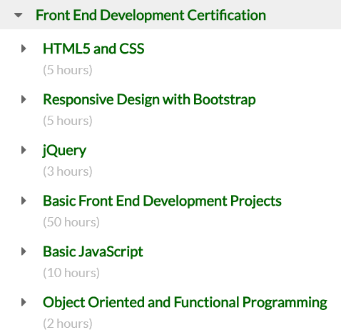
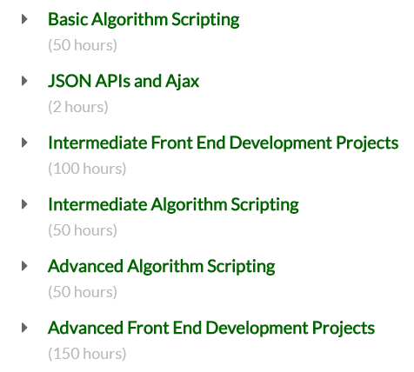
477 hours minimum, pre D3

Slide 7
learnwebdev.com:
11.5 hours for JavaScript alone

Slide 8

~10 hours reduced to 2
Notes:
You’re only going to get the JavaScript you need to start working in D3, you won’t get even close to a working grasp of the language at it’s full capacity

Slide 9
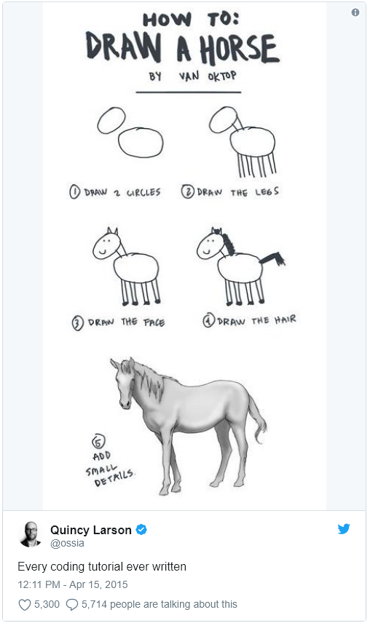

Slide 10
This Repo:
https://github.com/nuitrcs/Intro_to_d3_workshop
Notes:
2

Slide 11
Before I say anything, write this down:
console.log(this)

Slide 12
console.log(this) is your most powerful weapon
Use it. All the time.
It is your 6th sense in frontend development: it lets you ‘see’ where you are in your code and the DOM. It is your eyes into your scope, your selections, and your life.

Slide 13
Getting Started:
Task #1: Get your tools
Get a text editor: Sublime, Atom, Notepad++, or Brackets
Make sure you have either Chrome or Firefox
Task #2: Open your stuff
Open the “barchart_ready.html” file in your browser
Open the “barchart_ready.html” file in your text editor
Notes:
8, 6 & 2

Slide 14
A note about this dev environment
I will not be teaching: IDEs, task-runners, linting, sass, frameworks, or anything that you might want to consider in a full production environment
Why? Because those are beyond even the intro ‘10’ hour tutorials for JS. These are not within the scope of what we are learning – which is how to create things in D3.

Slide 15
Task #3: Some library-level JavaScript
Open ‘controller.js’ in your text editor, let’s walk through this

Slide 16
Task #4: Understanding AJAX failures
Open ‘barchart.html’ in CHROME
Open the inspector to read the error message

Slide 17
Task #5: Setting up a local server
Node.js:
From command line: npm install http-server –g
Run process.bat
Resource: https://github.com/indexzero/http-server
Python
Navigate to dir
Run:
Python 3x: python -m http.server
Python 2x: python -m SimpleHTTPServer
Resource: https://developer.mozilla.org/en-US/docs/Learn/Common_questions/set_up_a_local_testing_server

Slide 18
Port note:
You may need to specify a unique port number, if we all share an internal IP
Node: call http-server -p 9876 -c-1
Python: python -m http.server 9876

Slide 19
Task #6: Loading Async
Rename barchart.html to index.html
Navigate to http://localhost:[port]/ in your browser
Open the “index.html” file in your text editor
Observe differences between the two:
Data importing is different, odd JavaScript happens in barchart.html
A callback is used in barchart.html (this makes it async!)

Slide 20
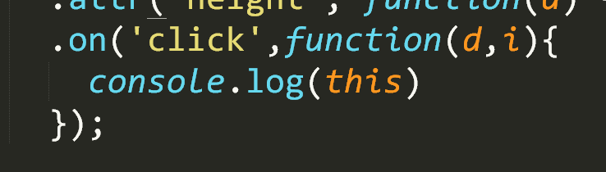
Task #7: Click Events – the easy way
Notes:
Explain generic functions, a thing in javascript
Console.log(this) and d and i

Slide 21
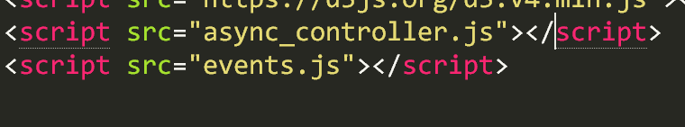
Task #8: Add a new javascript file

Slide 22
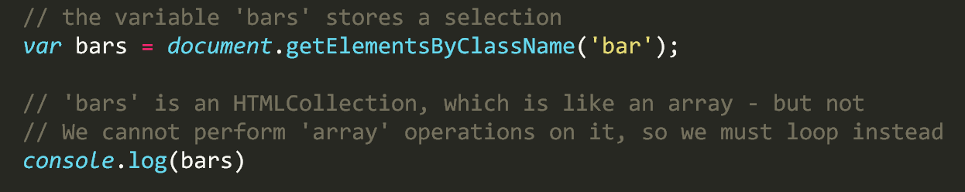
Task #9: Selecting

Slide 23
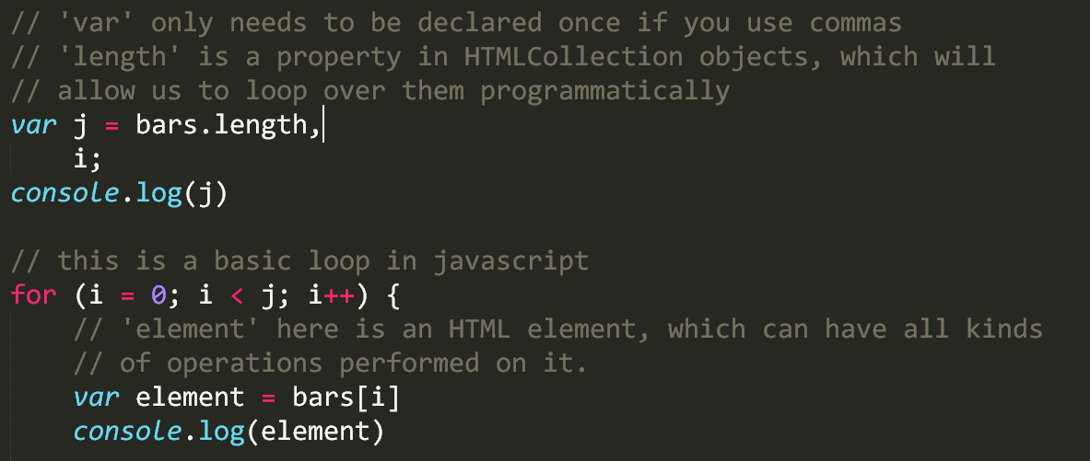
Task #10: Looping over a selection

Slide 24
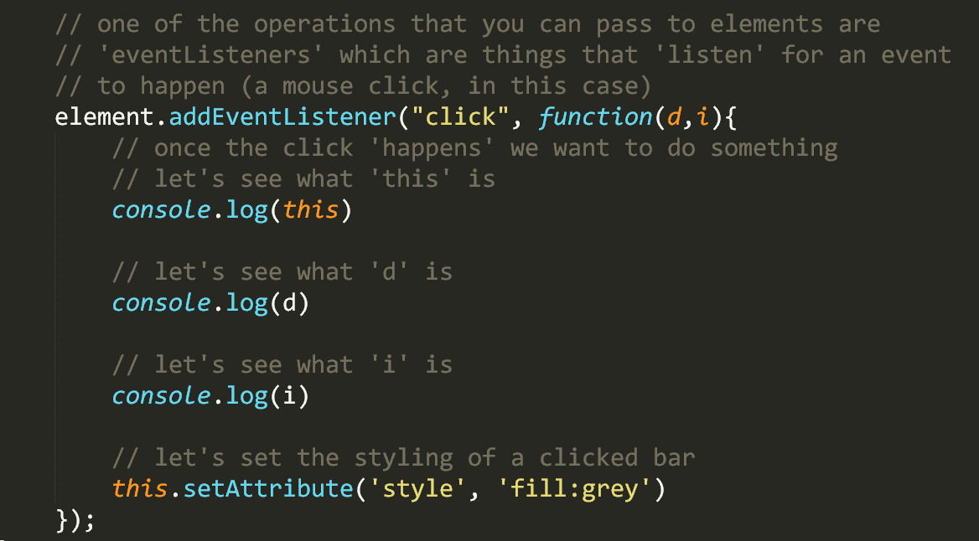
Task #11: Click events – the hard way

Slide 25
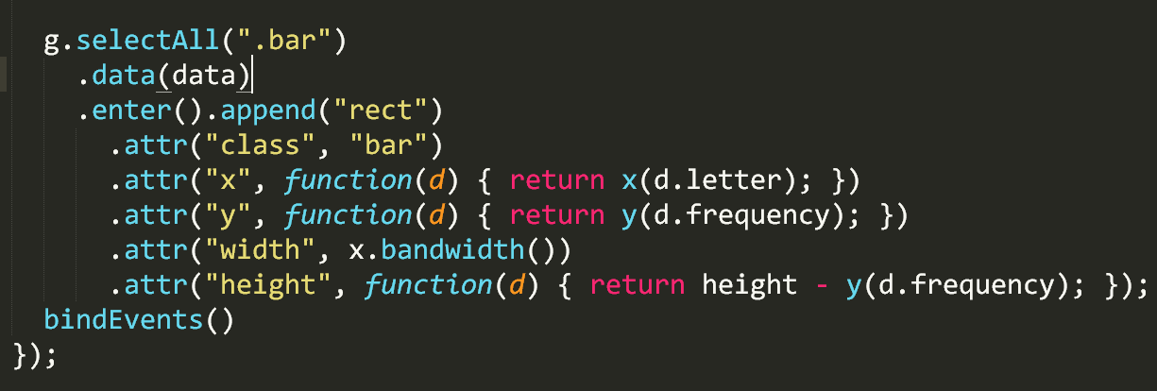
Task #12: Binding in a callback
(navigate to ‘async_controller.js’)

Slide 26
Questions?
Commonly asked JS:
What is the ‘development’ environment for JavaScript?
Is JavaScript compiled?
What is a library versus a framework?
What is an ‘API’? What is the ‘web API’?
Why is this all so complicated?
What is ‘loosely typed’?
Commonly asked D3:
Why would I ever use [sync]/[async]? X is obviously better.
Why is D3 so hard?

Slide 27
Now: Introduction to D3.js
Hands-on learning and plenty of resources.
Notes:
3

Slide 28
What is D3 capable of?
https://ligo.northwestern.edu/media/mass-plot/index.html
http://www.r2d3.us/visual-intro-to-machine-learning-part-1/
http://bit.ly/2wJEeIy
http://nbremer.github.io/urbanization/
https://www.nytimes.com/interactive/2014/upshot/buy-rent-calculator.htmlhttps://bost.ocks.org/mike/algorithms/
Notes:
3

Slide 29
But why is it so hard?
Why not just something like d3.call(bargraph).with(my_data)?
These solutions exist and you should use them when appropriate:
vega/vega-lite/altair
plotly
ggplot2
matplotlib
Notes:
1

Slide 30
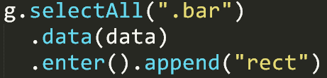
Two very important things:
Binding data to the DOM
Low-level geometric expressiveness
Notes:
3

Slide 31
Think of making a cake
How do most people do it?
Notes:
1 “Is box-cake even good though?”

Slide 32
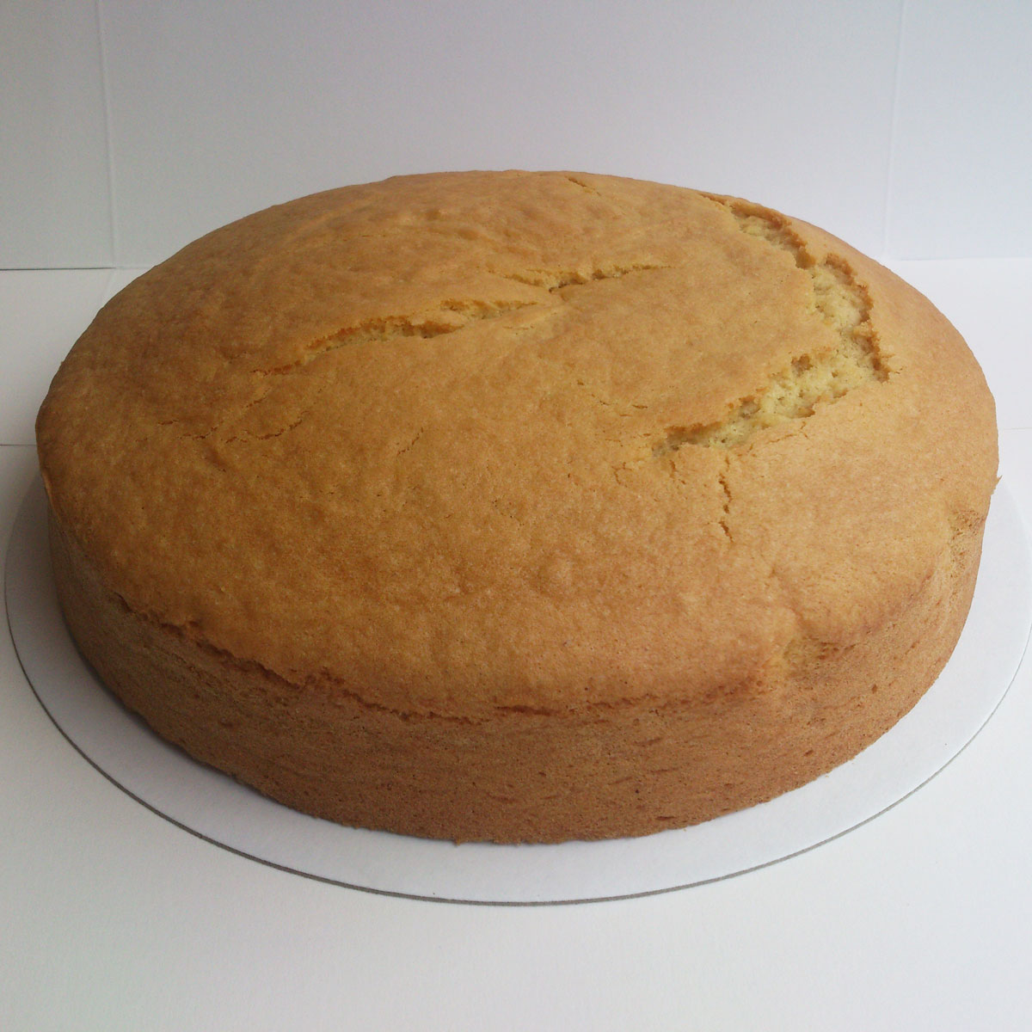
Microsoft Excel
Notes:
1

Slide 33

Plotly, ggplot2, Matplotlib
Notes:
1

Slide 34

Tableau, Vega
Notes:
1

Slide 35

D3 is tiramisu
Notes:
1

Slide 36

Or whatever cake you want
Notes:
1

Slide 37
“Boxed” cake is easy
Eggs + water + their pre-mixed flour,
Bake,
and then if you have the time: add frosting
In the end? Boring!
Notes:
1

Slide 38
Cake “from scratch” is hard:
You have to think about each ingredient, its quality, its needs
You must imagine your end-result + find a useful recipe
It can take a long time to master each ingredient
In the end? A unique masterpiece!
Notes:
2

Slide 39
Cake from Scratch
A “grammar of graphics” is key:
How do we talk about and use the core ingredients in any visualization?
Notes:
1 “Learn by doing” IDEAL: 15:00, latest TARGET = 22:00

Slide 40
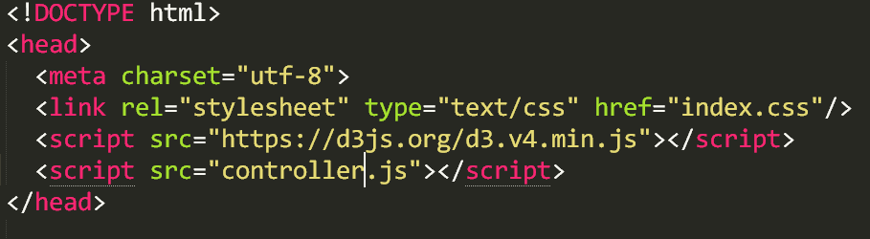
Task 1: Build your environment
Create a folder somewhere with these inside:
Build index.html file with d3 source link (local or web)
Create empty “index.css” file, link it in your html
Create empty “controller.js” file, link it in your html
Notes:
8

Slide 41
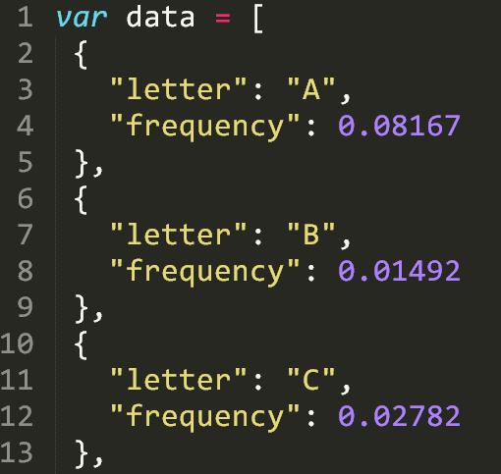
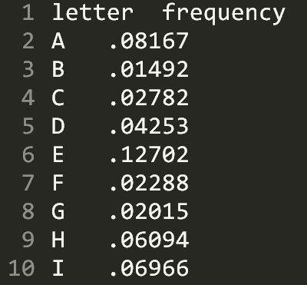
Task 2: Look at our data, literally
Open both data.tsv and data.js in your text editor
Notes:
4

Slide 42
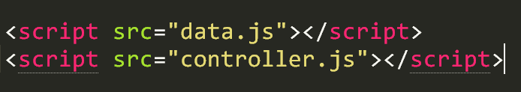
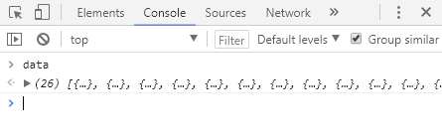
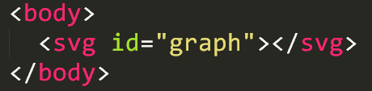
Task 3: Look at the data, in-browser
Import data.js into your html, copy this to your dev folder
Console.log the data in the browser console
Create an <svg> element with id=“graph” inside <body>
Notes:
6

Slide 43
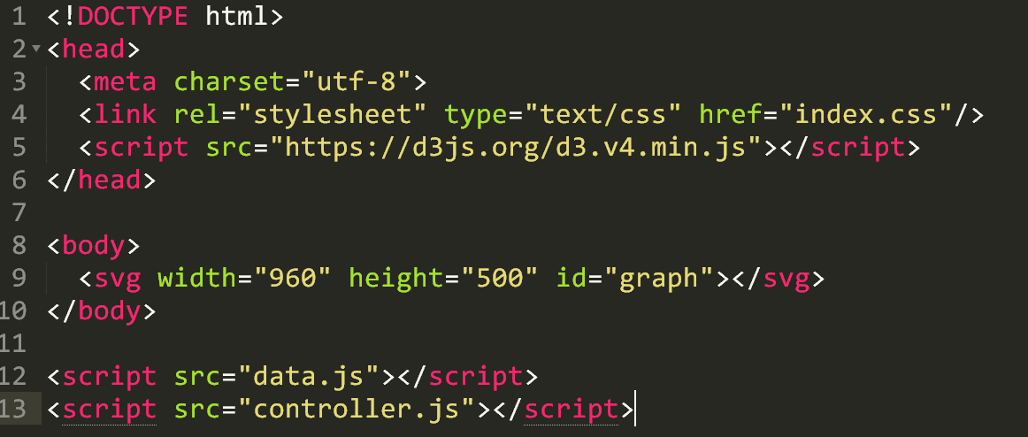
(Review) HTML layout should look like:
Notes:
3

Slide 44
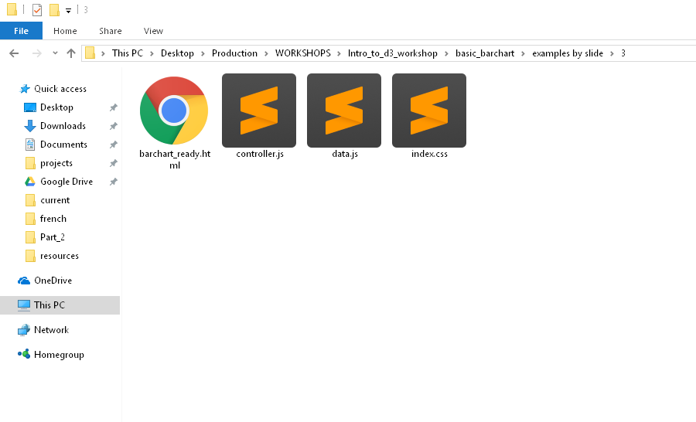
(Review) File system should look like:
Notes:
3

Slide 45
Begin writing code!
Let’s recreate this monster (follow along)
Notes:
1 – TARGET = 54:00, else -1 min each slide

Slide 46
1a. Beginning with D3
Once we get set up, we should only visit controller (and css)
Select the “#graph” element
Reference this with a var
Give it dimensions
Append g
Reference this g with a var
g.selectAll(‘.bar’)
.data(data)
.enter().append(‘rect’)
Discuss SVG types & explain SVG
Notes:
6

Slide 47
1b. Use the bound data!
Make height = d.frequency
Make width = 10
Make x = i*10
Try:
Make height = 1000x the frequency
Make width = 20
Make x = i*22
Notes:
6

Slide 48
1c. How to inspect
Show __data__ property of the element
Show console.log(this)
(i)
(d)
d3.select(this)
Notes:
6

Slide 49
2. Build a scale that makes sense
Create margin object
Create “actual” width/height variables, subtracting the margins
Pass these to x range - band (width) and y range - linear (height)
Pass our data to the domain, using map for letters and max for frequency
Update our attr binding to use these new things
Notes:
6

Slide 50
3. Add the axes and some styling
Append g with an axisBottom on x, translate for height (to put on bottom – otherwise it is a downward axis on the top)
Append g with an axis for y, add 10 ticks with %
Open our empty index.css
Add fill color for .bar class and .bar:hover
Remove axis--x path
Notes:
6

Slide 51
Done? Great. One last exercise:
Recreate your code, but make it asynchronous and load once you click the ‘body’ element

Slide 52
Resources
Things you should explore when looking further

Slide 53
Read the API docs!
D3: https://github.com/d3/d3/wiki
Web: https://developer.mozilla.org/en-US/

Slide 54
Top 3 resources:
The d3 API documentation
MDN web standards documentation
Googling things you want to make (“d3 scatterplot bl.ocks”)

Slide 55
Listing the Basics:
Know what these are, you will use them often:
Selections (select, selectAll and how they work)
SVG types (circle, rect, text, path)
Data Enter/Append
Data Exit/Remove
Chaining
Attributes+Transitions
Arrays: Min/Max/Range, Keys, Merge, Nest
Scales
Color
Axes

Slide 56
Design Basics for Charts
http://bit.ly/1RfYZxm
Worth mentioning: There are additional slidedecks by the above authors on Maps, Pie Charts, and even Data Tables

Slide 57
Advanced d3 Abilities
Curve Interpolations: http://bit.ly/2xR9VxX
Voronoi: http://bit.ly/2gK35mi
https://bl.ocks.org/mbostock/4060366
Zooming: http://bit.ly/2f6WYsg
Brushing/Zooming: http://bit.ly/2lTjfef
Stacking: http://bl.ocks.org/mbostock/582915
Collision Constraint: http://bit.ly/2vOPk05
Dragging: http://bit.ly/2j6x5gH
“Each”: https://bl.ocks.org/mbostock/9490313
Dispatching (super advanced): https://bl.ocks.org/mbostock/5872848
Modules/Plugins (most advanced):
https://bost.ocks.org/mike/d3-plugin/

Slide 58
SVG Documentation
https://mzl.la/1nP24aN
Check it: this is good to be familiar with, as is all of MDN

Slide 59
SVG Level 2
http://bit.ly/2xdgJsI
Plug: VisualCinnamon is extraordinary. Their work on SVG in particular is the best I have found to date.

Slide 60
Maps in D3
http://bit.ly/2f7o4Q5
http://oreil.ly/1UnNtFe
Warning: This is advanced level!
Also: The d3 library contains geo maps of many kinds already.

Slide 61
D3’s Extensive Library:
https://github.com/d3/d3/blob/master/API.md
Statistics, histograms (4 kinds), ES6’s Map/Set, Nesting, Data Ingestion (CSV, TSV, etc), many animation/easing/time options, force/physics, geography and projections, spherical maps/math, and that is just the first 25% of it:

Slide 62
Canvas and D3
http://bit.ly/2xRh9Ci
Important: Canvas is a native web technology, similar to SVG. You can google the comparisons, but it is a good option if you need serious performance over visual quality.

Slide 63
Data Processing in JS
http://learnjsdata.com/index.html
Note: optional resource. This is very nice to have handy.

